Slide 1

Group 4 Haven Bag Shop Presentation
Group 4 Members:
Mai Anh Vu
Nguyen Dinh Thai An
Pham Minh Quang

Slide 2
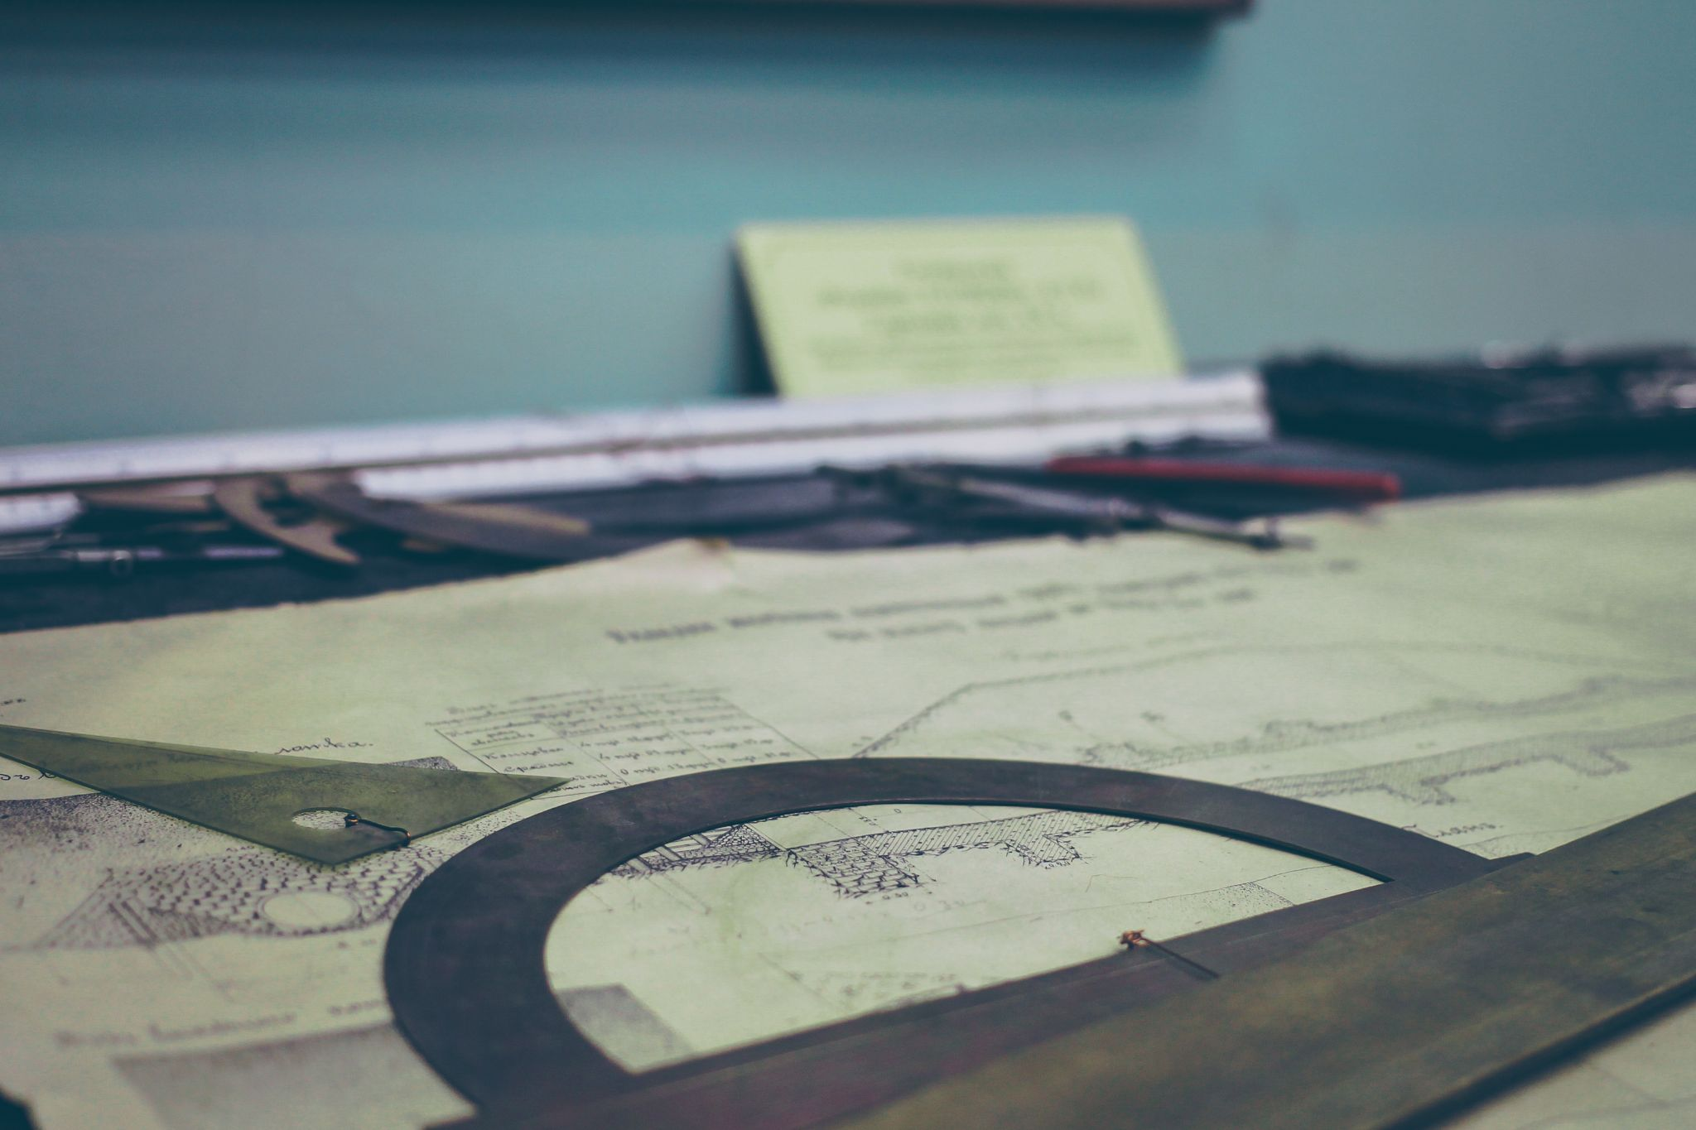
Work disposition for all members:
Mai Anh Vu:
Main page product display of latest products (3 recently added to database)
Product’s management on admin side: Add/Edit/Delete products.
Order Overview and resolving order + cart page logic.
Nguyen Dinh Thai An:
Admin account login.
Customer account creation, and login logic.
Account Management: Enable and disable customer account.

Slide 3

Work disposition for all members:
Pham Minh Quang:
Product page display, product specific display, user review + rating and user feedback.

Slide 4



